Slide 1
Image Repository Manger and Web developer
Entry level role within team
Applying Java Script to customise XNAT platform
Improving the capabilities of XNAT for the wider cancer imaging community

Slide 2
Progress so far
Provide a universal, secure, open source PACS for both Clinical and Academic data
Accommodate for different environments, data types and workflows
Clinical data Pseudo anonymization
Able to store a variety of different data (MR, CT, XRAY, PET, US)
Post processing statistics (histograms, simulations)
Clear audit trail for reproducibility studies
Doran et al. Radiographics 32, 2135–2150 (2012)
Notes:
4D, 3D

Slide 3
The Future
User testing XNAT ML (Beta)
ICR Data Chooser, Uploader
Doran et al. Radiographics 32, 2135–2150 (2012)

Slide 4
My Experience with Medical Imaging
Functional Medical Imaging
Work experience in NHS Nottingham Medical Physics department
Image Processing Module
Msci Project ASL MRI:
  - Voxel wise Simulation and Modelling of Blood perfusion
  Monte Carlo methods
Online course on Beginner JavaScript
Notes:
CT, PET, fMRI
Morphological image processing, ICA, PCA, Butterworth filters
Saw people using XNAT within radio therapy and treatment planning, appreciate the importantce of its accuracy

Slide 5
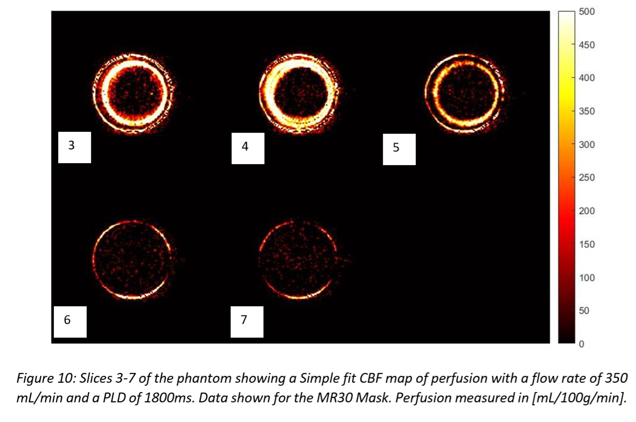
Developing Arterial Spin Labelling MRI for Non-Invasive Measurement of Brain Blood Flow
Daniel Morris Supervisor: Prof. Sue Francis
Charlotte Buchanan
Abstract: This report explores new experimental developments in ASL within the context of the QASPER Gold Standard Phantom with the aim of improving the reliability and precision of quantitative perfusion data using pCASL. When adopting the two main methods for quantifying perfusion Single-PLD and Multi-PLD; the data using Single-PLD were more successful, obtaining a fitted value of perfusion of 220 ± 80 mL/100g/min using a thresholding mask and the phantom with a flow rate of 350mL/min and label time 1800ms. This method was subsequently applied to brain data to give a mean perfusion across grey and white matter of 110 ± 40 mL/100g/min. Monte Carlo simulations were also run as a guide to improve how phantom data is collected and processed in the future.

Slide 6
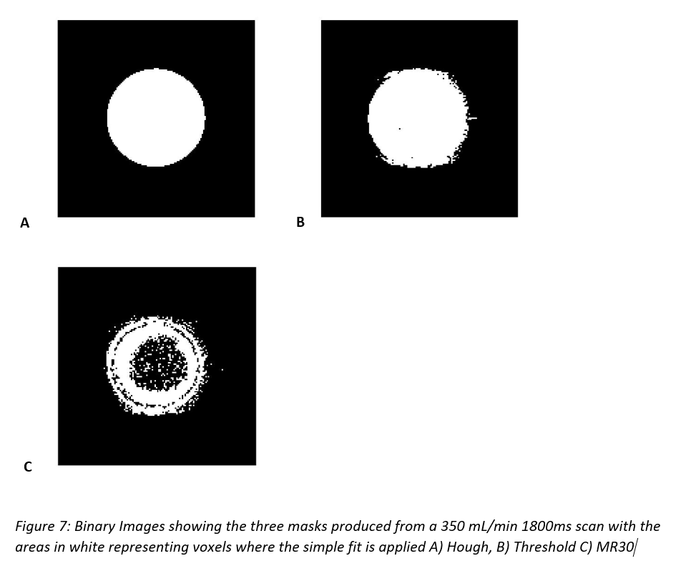
Masking
Notes:
3 masking options for simple fit for identifying the ROI

Slide 7
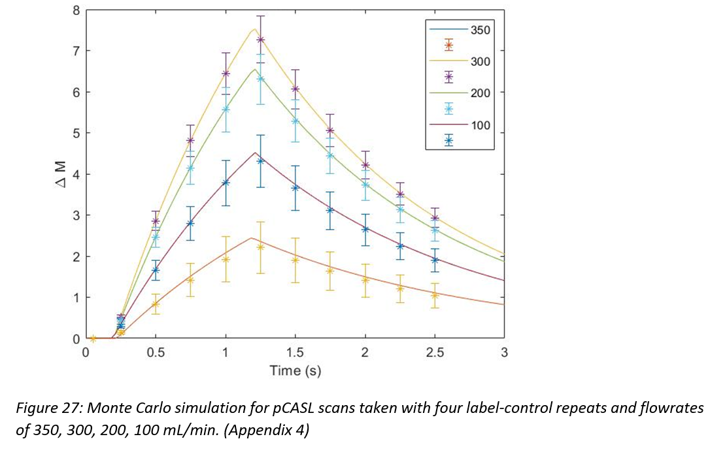
Monte Carlos
Notes:
Simulation of GKM curves where the error bars are derived from the SD of 1000 monte carlo loops

Slide 8

Notes:
Mathematical perturbations cause permanent irreversible changes to images under gone ML.
Important that a medical ML standard is developed before implementation.

